Slide 1

50.039 Theory and Practice of Deep Learning W6-S2 Times Series Data and Recurrent Neural Networks
Matthieu De Mari

Slide 2
About this week (Week 6)
What is a time series dataset?
How to analyze a time series, and what are typical deep learning models capable of doing that?
What is history, and why is it needed for time series predictions?
What is a good history length?
What is memory and how to represent it in a Neural Network model?
How to implement a first vanilla Recurrent Neural Network model?
Why is the vanishing gradient problem prominent in RNNs?

Slide 3
About this week (Week 6)
What is the LSTM model?
What is the GRU model?
What are one-to-one, one-to-many, many-to-one and many-to-many models?
What are some typical application examples of these?
What is a Seq2Seq model?
What are encoder and decoder architectures?
What is an autoregressive RNN?

Slide 4
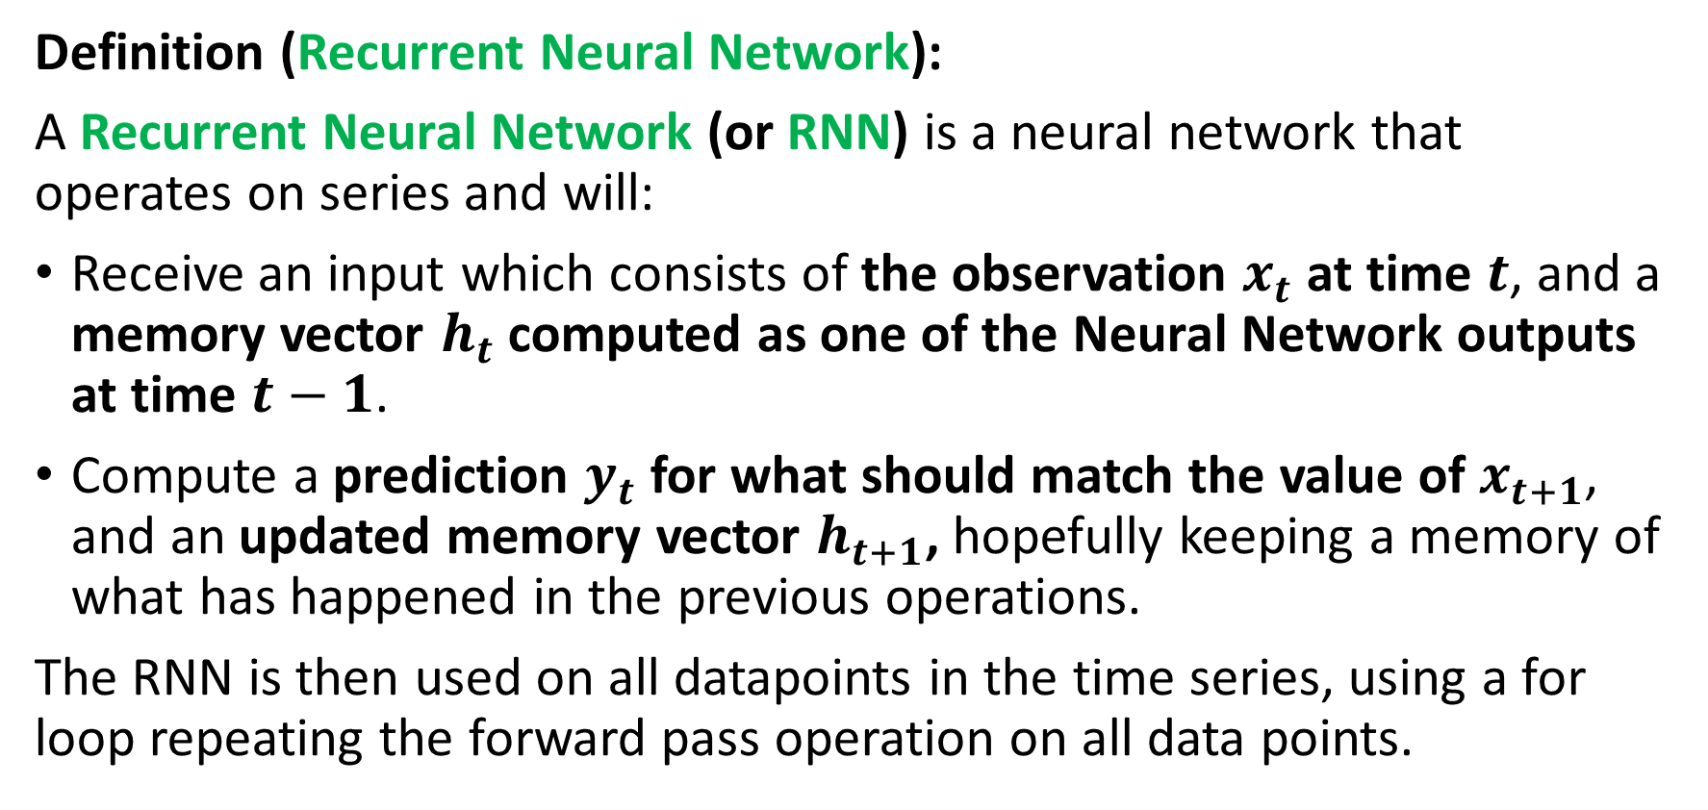
Defining a Recurrent Neural Network (RNN)
Definition (Recurrent Neural Network):
A Recurrent Neural Network (or RNN) is a neural network that operates on series and will:
Receive an input which consists of the observation $x_{t}$ at time $t$, and a memory vector $h_{t}$ computed as one of the Neural Network outputs at time $t−1$.
Compute a prediction $y_{t}$ for what should match the value of $x_{t+1}$, and an updated memory vector $h_{t+1}$, hopefully keeping a memory of what has happened in the previous operations.
The RNN is then used on all datapoints in the time series, using a for loop repeating the forward pass operation on all data points.

Slide 5

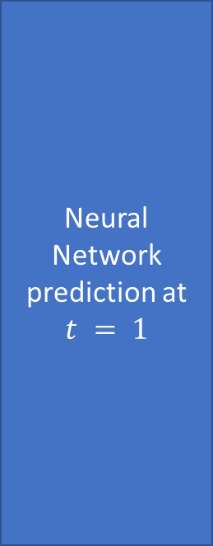
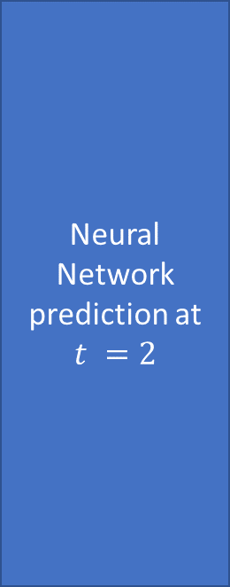
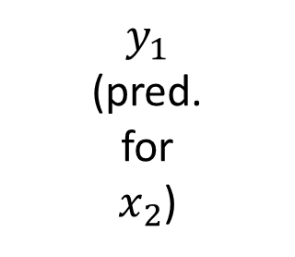

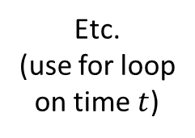



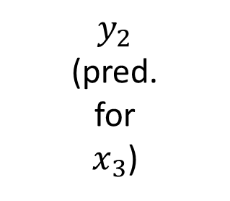
The need for memory
Neural Network prediction at $t = 1$
$$y_{1}$$
(pred. for $x_{2}$)
Neural Network prediction at $t =2$
$$y_{2}$$
(pred. for $x_{3}$)
$$x_{1}$$
$$x_{2}$$
Etc.
(use for loop on time $t$)
$$h_{0}=zeros(l)$$
$$h_{1}$$
$$h_{2}$$

Slide 6
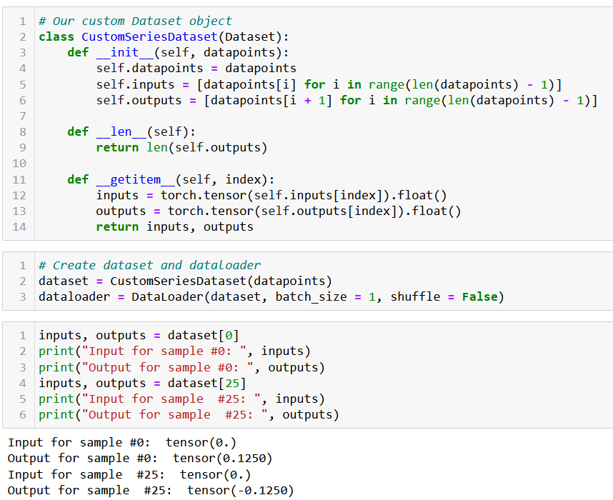

Slide 7
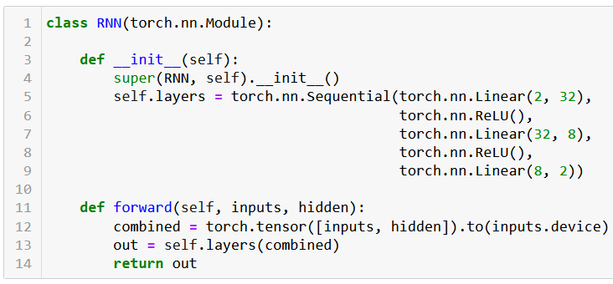
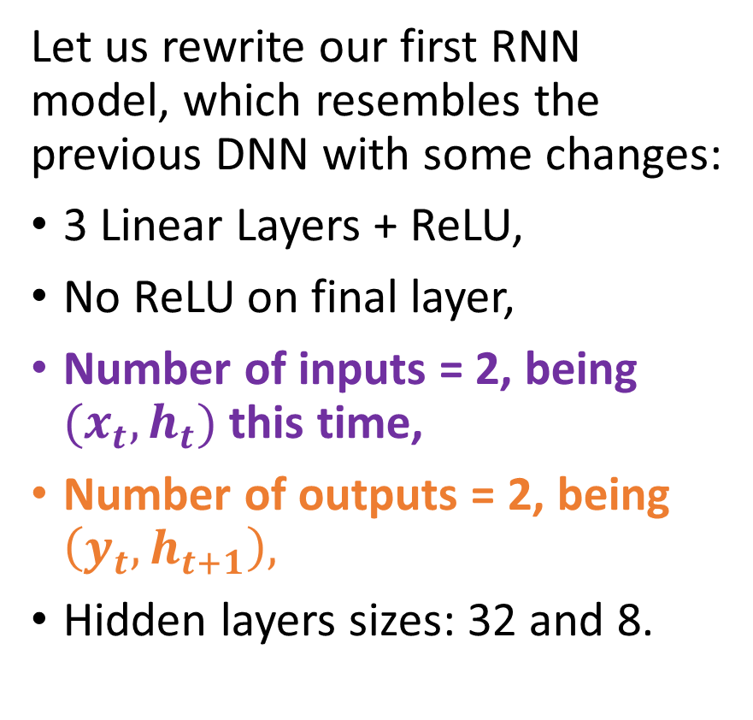
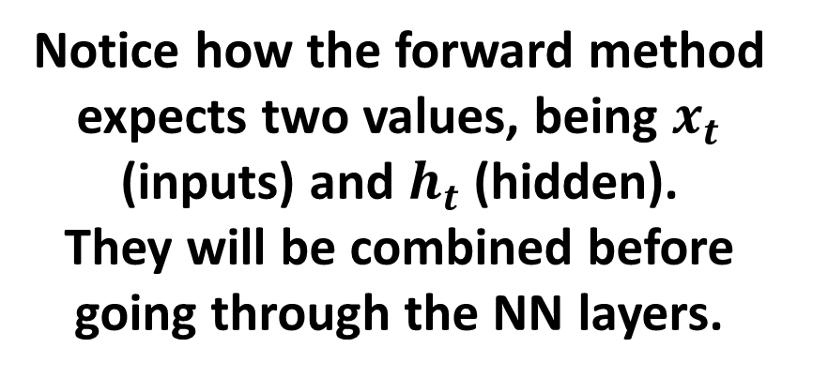
Implementing a RNN
Let us rewrite our first RNN model, which resembles the previous DNN with some changes:
3 Linear Layers + ReLU,
No ReLU on final layer,
Number of inputs = 2, being $(x_{t},h_{t})$ this time,
Number of outputs = 2, being $\left(y_{t}, h_{t+1}\right),$
Hidden layers sizes: 32 and 8.
Notice how the forward method expects two values, being $x_{t}$ (inputs) and $h_{t}$ (hidden).
They will be combined before going through the NN layers.

Slide 8
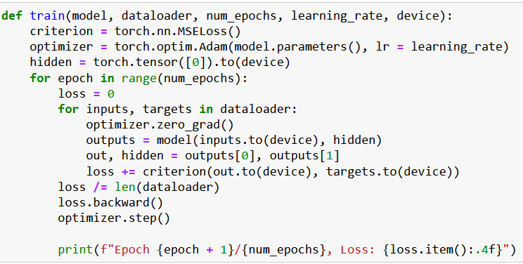
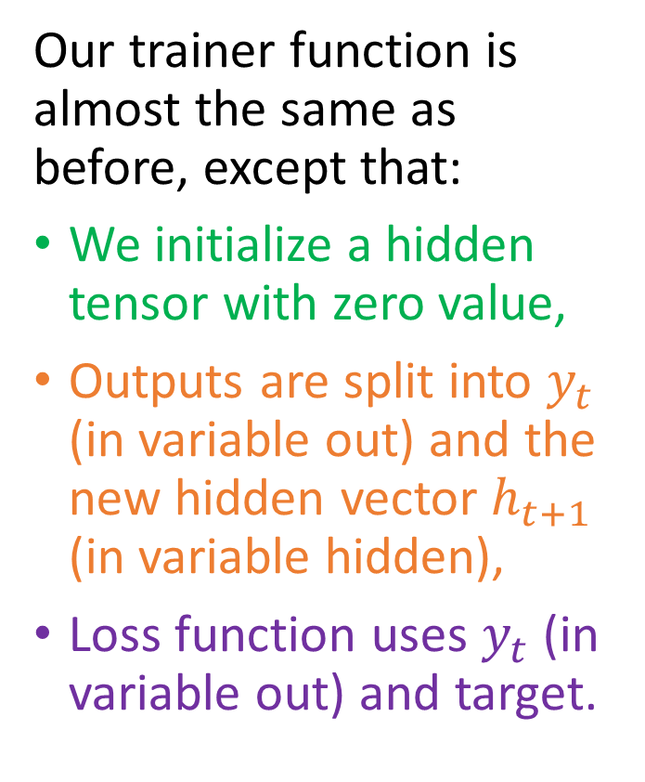
Implementing a RNN
Our trainer function is almost the same as before, except that:
We initialize a hidden tensor with zero value,
Outputs are split into $y_{t}$ (in variable out) and the new hidden vector $h_{t+1}$ (in variable hidden),
Loss function uses $y_{t}$ (in variable out) and target.

Slide 9
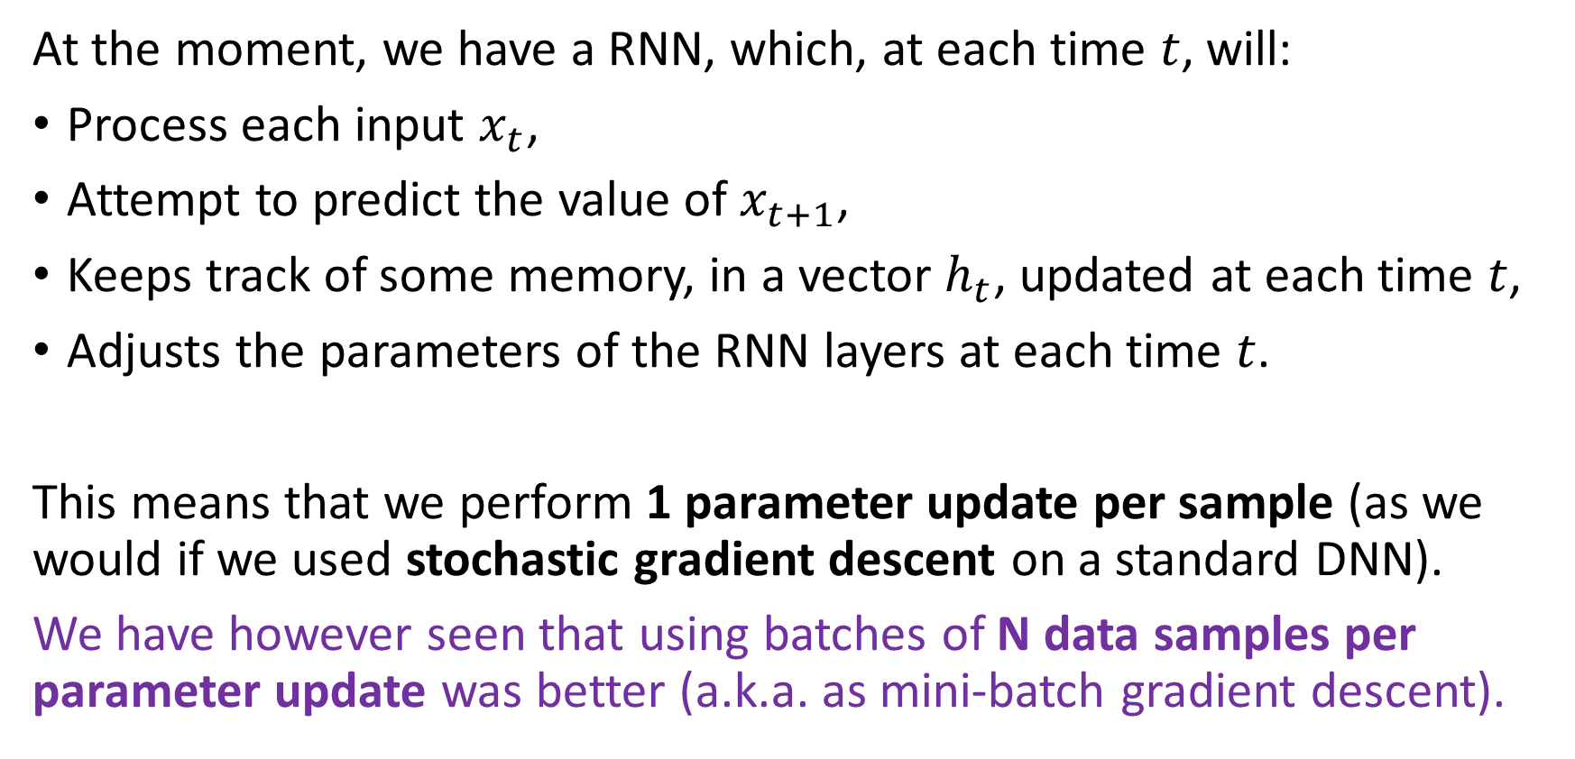
Backpropagation through time
At the moment, we have a RNN, which, at each time $t$, will:
Process each input $x_{t}$,
Attempt to predict the value of $x_{t+1}$,
Keeps track of some memory, in a vector $h_{t}$, updated at each time $t$,
Adjusts the parameters of the RNN layers at each time $t$.
This means that we perform 1 parameter update per sample (as we would if we used stochastic gradient descent on a standard DNN).
We have however seen that using batches of N data samples per parameter update was better (a.k.a. as mini-batch gradient descent).

Slide 10
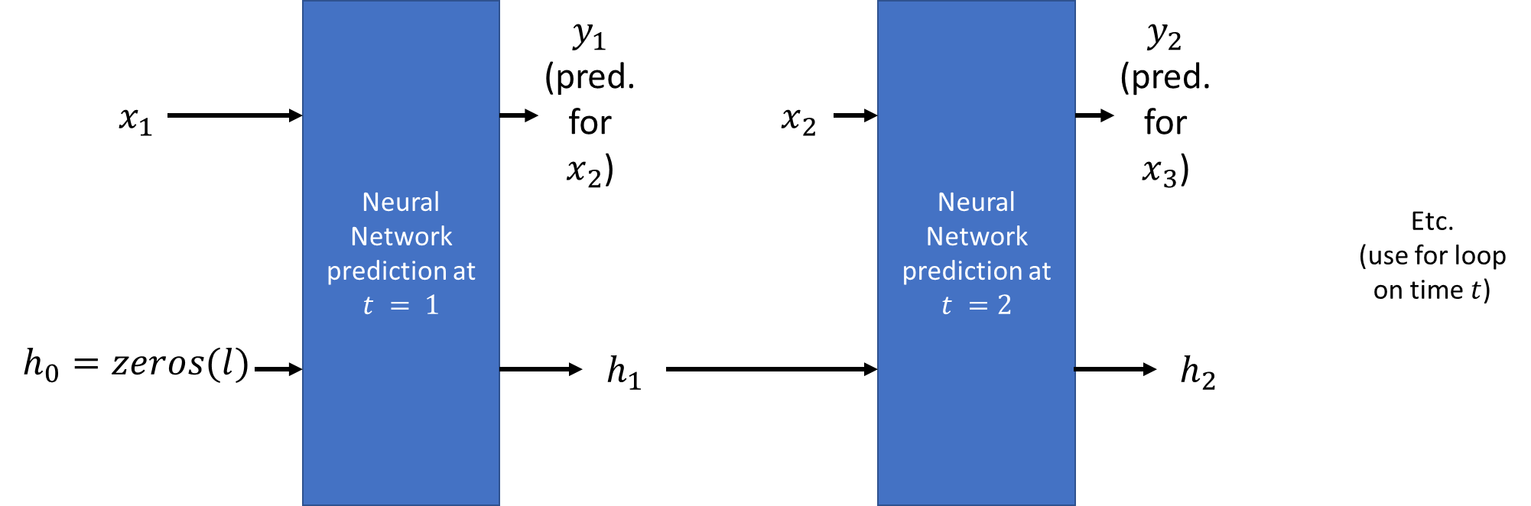
Backpropagation through time
Definition (backpropagation through time):
In order to implement a parameter update every N samples, we need to implement a backpropagation through time.
Unfold the RNN operations over time as shown,
Run predictions on N consecutive samples and keep track of loss,
Eventually perform one parameter update after N samples.
This basically allows to teach the RNN how to update the memory vectors over time.
Somewhat equivalent to a chain of successive layers, with gradient propagated through all the layers and time steps.

Slide 11
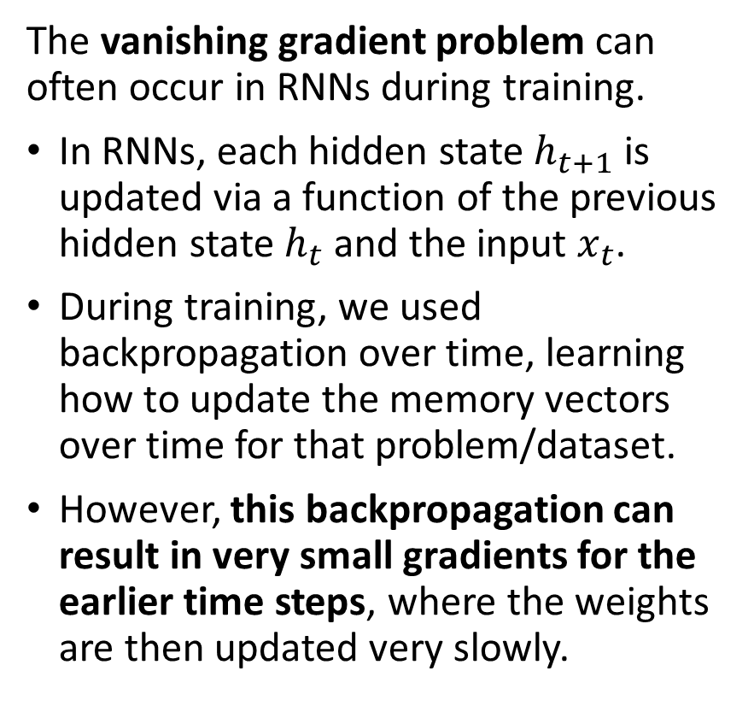
The vanishing gradient problem (part 3)
The vanishing gradient problem can often occur in RNNs during training.
In RNNs, each hidden state $h_{t+1}$ is updated via a function of the previous hidden state $h_{t}$ and the input $x_{t}$.
During training, we used backpropagation over time, learning how to update the memory vectors over time for that problem/dataset.
However, this backpropagation can result in very small gradients for the earlier time steps, where the weights are then updated very slowly.
This can be particularly problematic for RNNs, since they are designed to handle time series data that can exhibit long-term dependencies.
The vanishing gradient problem can be particularly severe in RNNs that use activation functions that saturate, such as the hyperbolic tangent (tanh) or sigmoid functions.
Indeed, when the activation function saturates, the gradients become very small, making it difficult to propagate information through the network.

Slide 12
The vanishing gradient problem (part 3)
How to address the vanishing gradient problem in RNNs?
Several techniques have been developed to address the vanishing gradient problem in RNNs, such as using alternative activation functions, initializing the weights of the network carefully, etc.
The “best” (?) solution requires using specialized architectures like Long Short-Term Memory (LSTM) networks or Gated Recurrent Units (GRUs) to process memory.
These are designed to better handle long-term dependencies, and can help to mitigate the vanishing gradient problem.
This eventually improves the performance of RNNs on time series.

Slide 13
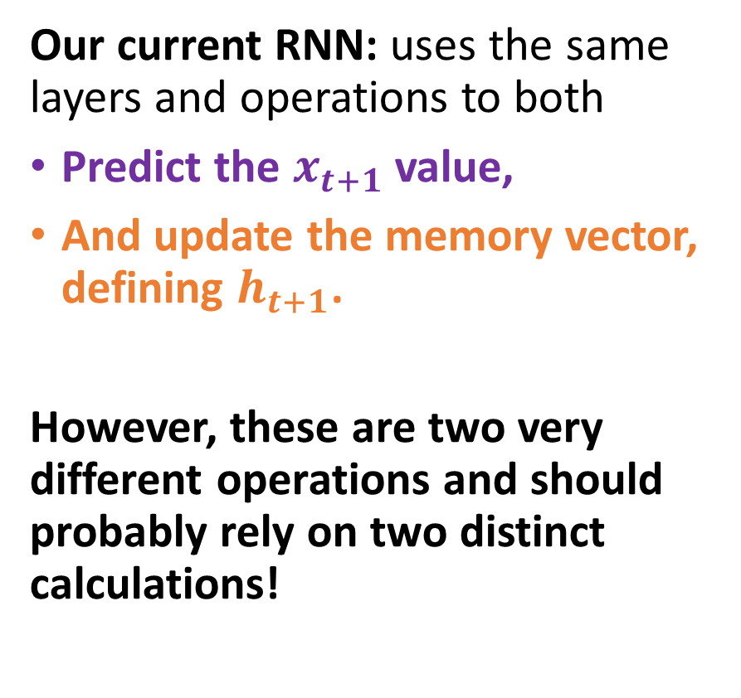
Core idea behind GRU and LSTM models
Our current RNN: uses the same layers and operations to both
Predict the $x_{t+1}$ value,
And update the memory vector, defining $h_{t+1}$.
However, these are two very different operations and should probably rely on two distinct calculations!

Slide 14
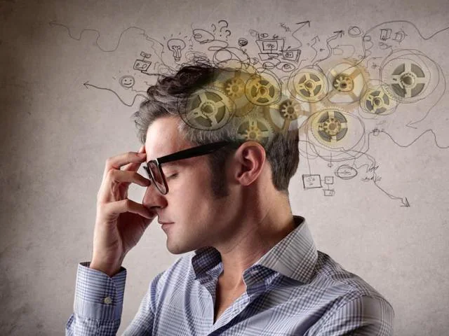
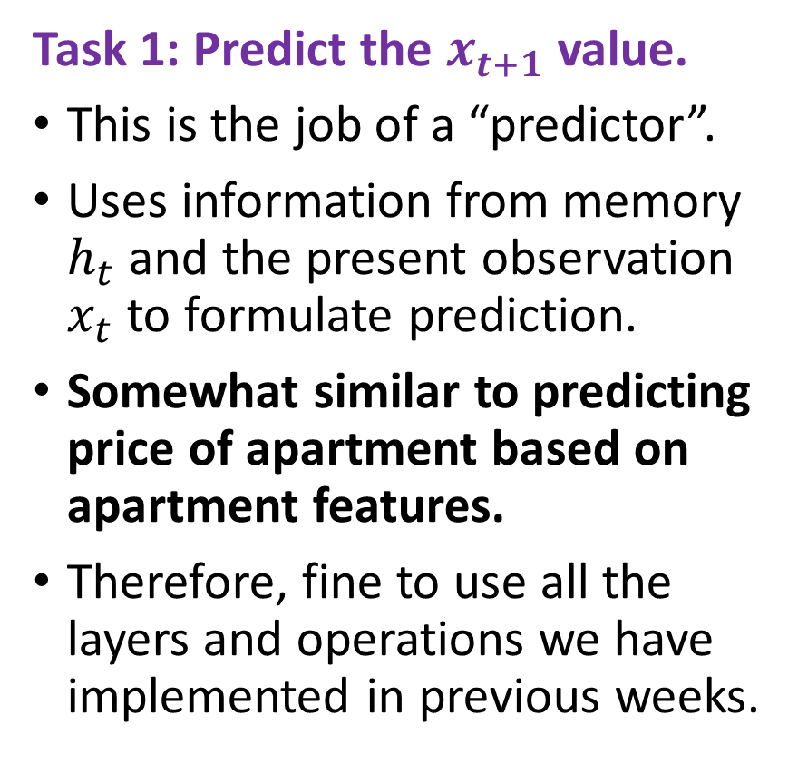
Core idea behind GRU and LSTM models
Task 1: Predict the $x_{t+1}$ value.
This is the job of a “predictor”.
Uses information from memory $h_{t}$ and the present observation $x_{t}$ to formulate prediction.
Somewhat similar to predicting price of apartment based on apartment features.
Therefore, fine to use all the layers and operations we have implemented in previous weeks.

Slide 15
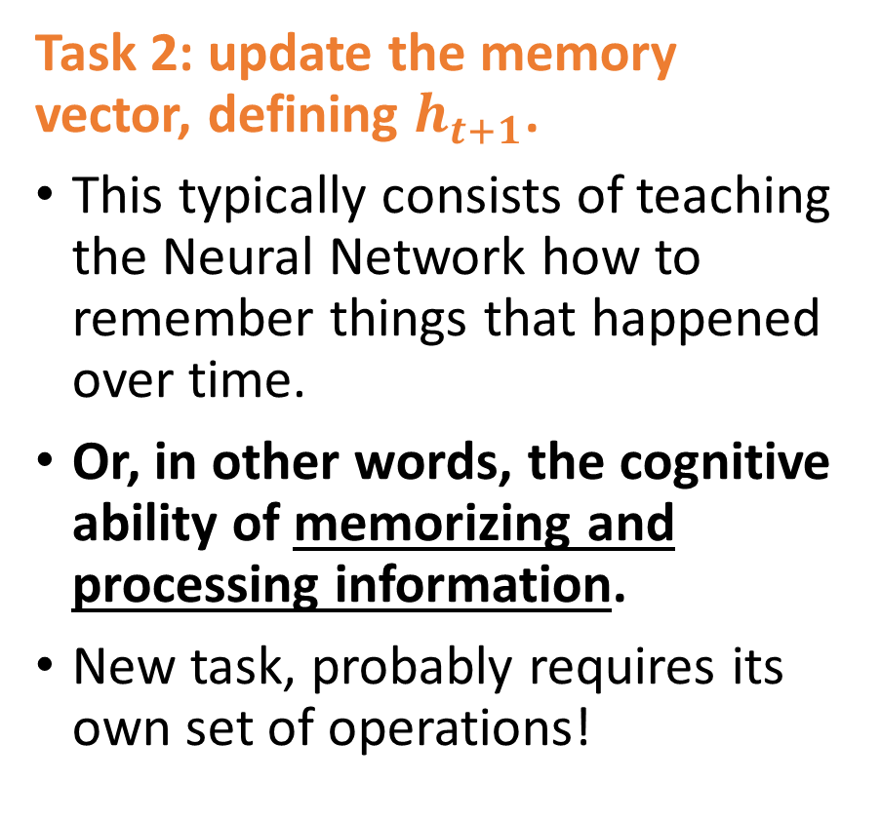
Core idea behind GRU and LSTM models
Task 2: update the memory vector, defining $h_{t+1}$.
This typically consists of teaching the Neural Network how to remember things that happened over time.
Or, in other words, the cognitive ability of memorizing and processing information.
New task, probably requires its own set of operations!

Slide 16
Core idea behind GRU and LSTM models
But, hold on a second, what is the brain doing when it comes to memory anyway?
Brain will decide what is an important information to remember over time,
But it might also choose to forget about information that is no longer relevant!
(Basically freeing space in the memory of your brain!)
Learn more about memory and the brain, here: https://lesley.edu/article/stages-of-memory

Slide 17
Core idea behind GRU and LSTM models
How to improve our current vanilla RNN (shown):
Have distinct sets of trainable parameters for the neural network (one set for each task),
And different sets of operations happening in the forward method (again, one set for each task).
Decorrelate both tasks!

Slide 18
Introducing LSTM
Definition (Long Short-Term Memory models):
LSTMs (Long Short-Term Memory models) are a type of recurrent neural network architecture introduced in [Hochreiter1997] and revised in [Gers2013].
LSTMs aim to solve the vanishing gradient problem in RNNs, by adding gating mechanisms to selectively update and discard information in the cell state. In other words, LSTMs use gating mechanisms to regulate the flow of information within the network.
This allows the model to selectively choose which information from the previous cell state to retain and which to discard, in order to give more importance to recently predicted values, for instance.

Slide 19
Introducing LSTM
The cell state can be seen as a conveyor belt that carries information, or memory, across the network.
The gates can either allow or prevent information from flowing through the belt.
This feature makes LSTMs better suited for modelling complex time series data that exhibit long-term dependencies, as they can selectively choose which information to remember or forget at each time step, depending on the input and the context.
Therefore, mimicking the behavior of the human brain!

Slide 20
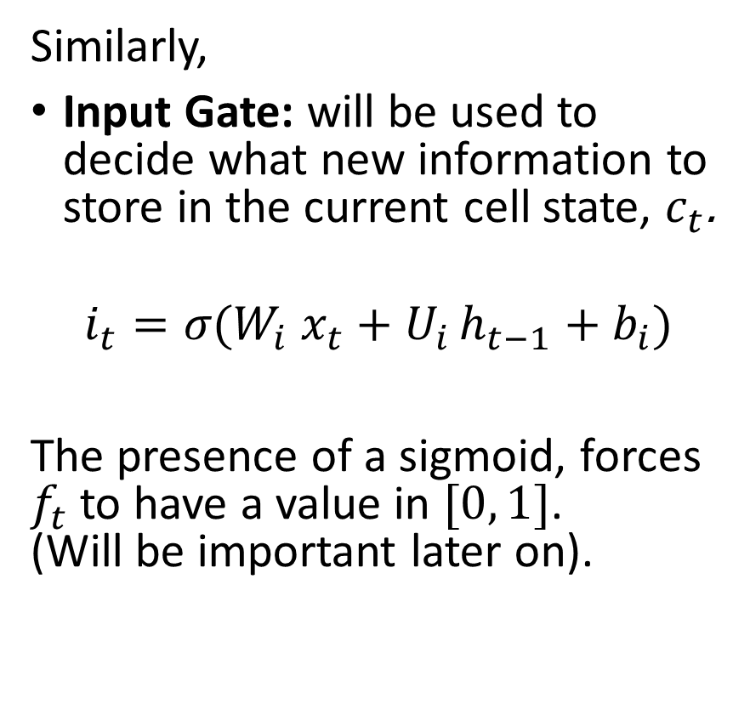
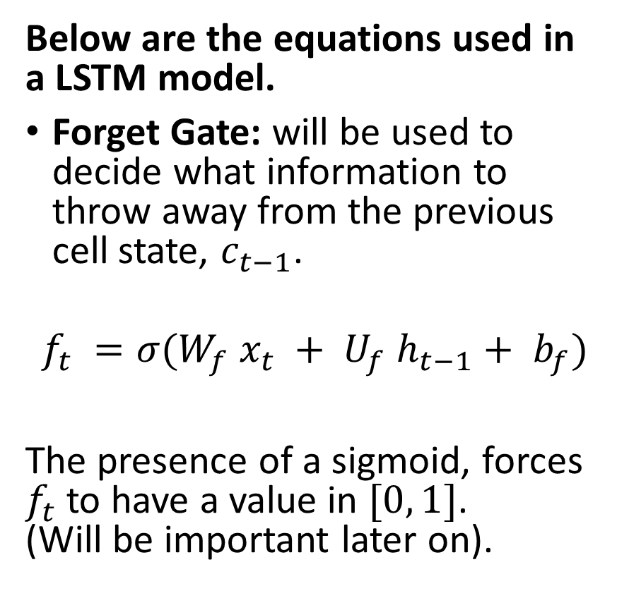
Introducing LSTM
Below are the equations used in a LSTM model.
Forget Gate: will be used to decide what information to throw away from the previous cell state, $c_{t−1}$.
$$f_{t} =σ(W_{f} x_{t} + U_{f} h_{t−1}+ b_{f})$$
The presence of a sigmoid, forces $f_{t}$ to have a value in $[0, 1]$. (Will be important later on).
Similarly,
Input Gate: will be used to decide what new information to store in the current cell state, $c_{t}$.
$$i_{t}​=σ​(W_{i}​{ x}_{t}​+U_{i }​h_{t−1}​+b_{i}​)$$
The presence of a sigmoid, forces $f_{t}$ to have a value in $[0, 1]$. (Will be important later on).

Slide 21
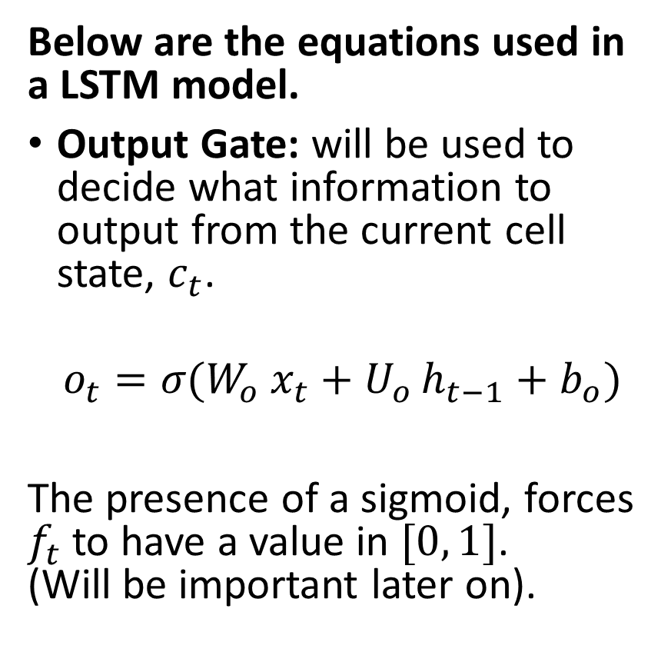
Introducing LSTM
Below are the equations used in a LSTM model.
Output Gate: will be used to decide what information to output from the current cell state, $c_{t}$.
$$o_{t}​=σ​(W_{o}​{ x}_{t}​+U_{o }​h_{t−1}​+b_{o}​)$$
The presence of a sigmoid, forces $f_{t}$ to have a value in $[0, 1]$. (Will be important later on).
Important to note:
All three equations for the forget, input and output gates seem to be following the same logic.
However, they have their own sets of parameters (weights and biases), which can be trained independently later on.

Slide 22
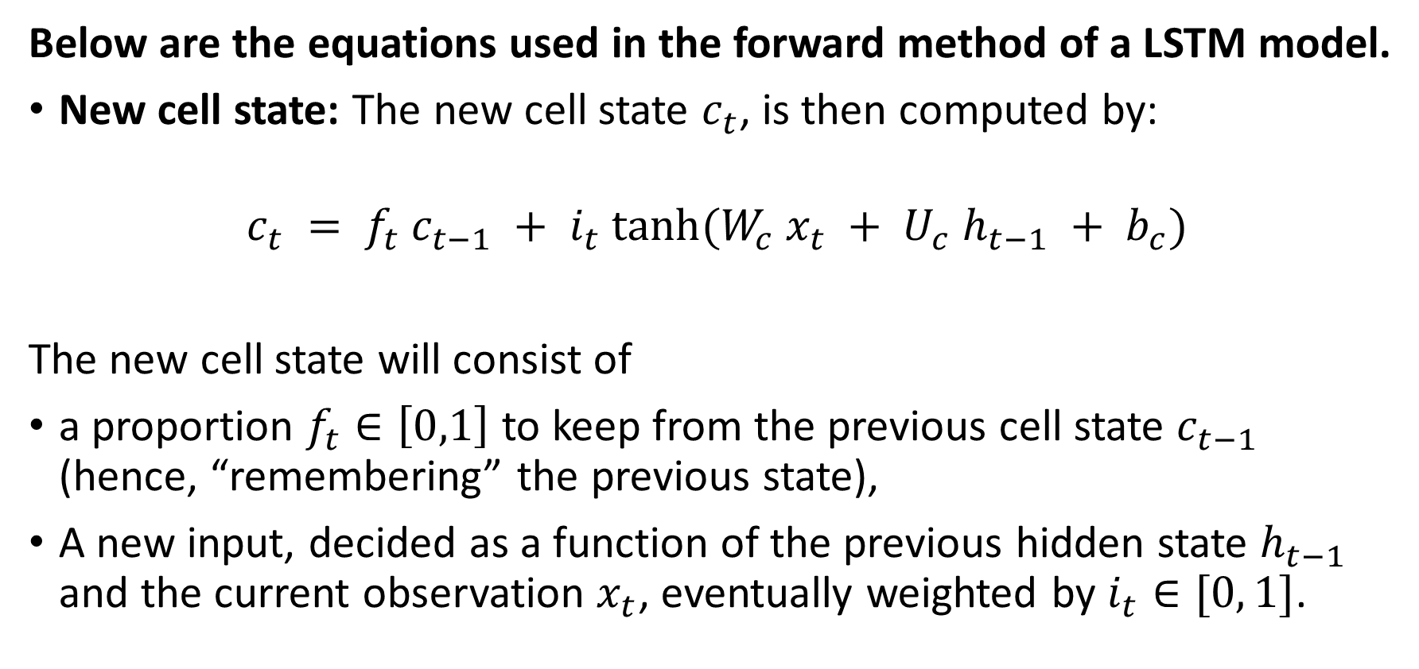
Introducing LSTM
Below are the equations used in the forward method of a LSTM model.
New cell state: The new cell state $c_{t}$, is then computed by:
$$c_{t} = f_{t} c_{t−1} + i_{t} tanh⁡(W_{c} x_{t} + U_{c} h_{t−1} + b_{c})$$
The new cell state will consist of
a proportion $f_{t}∈\left[0,1\right]$ to keep from the previous cell state $c_{t−1}$ (hence, “remembering” the previous state),
A new input, decided as a function of the previous hidden state $h_{t−1}$ and the current observation $x_{t}$, eventually weighted by $i_{t}∈[0, 1]$.

Slide 23
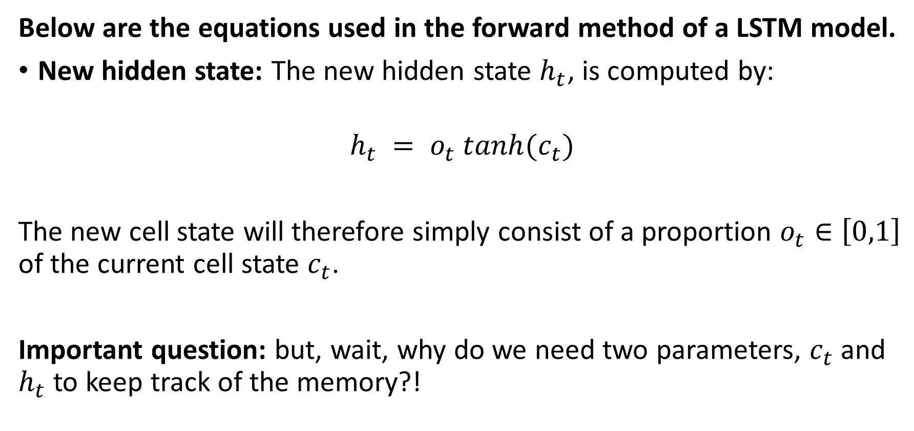
Introducing LSTM
Below are the equations used in the forward method of a LSTM model.
New hidden state: The new hidden state $h_{t}$, is computed by:
$$h_{t} = o_{t} tanh(c_{t})$$
The new cell state will therefore simply consist of a proportion $o_{t}∈\left[0,1\right]$ of the current cell state $c_{t}$.
Important question: but, wait, why do we need two parameters, $c_{t}$ and $h_{t}$ to keep track of the memory?!

Slide 24
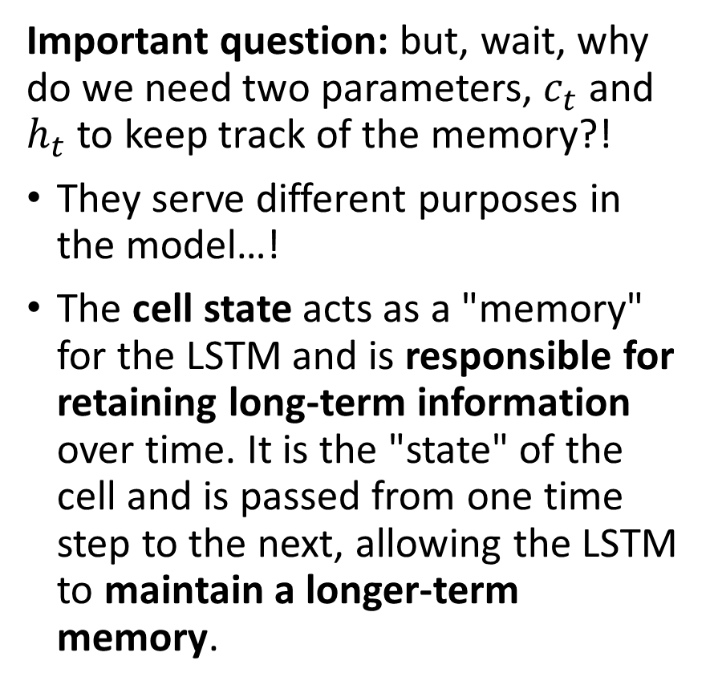
Introducing LSTM
Important question: but, wait, why do we need two parameters, $c_{t}$ and $h_{t}$ to keep track of the memory?!
They serve different purposes in the model…!
The cell state acts as a "memory" for the LSTM and is responsible for retaining long-term information over time. It is the "state" of the cell and is passed from one time step to the next, allowing the LSTM to maintain a longer-term memory.
The hidden state, on the other hand, is used to output the prediction and capture shorter-term dependencies in the data. It serves as a kind of "working memory" that allows the model to capture patterns in the input data over shorter time periods.
Separating both helps the model avoid the vanishing gradient problem and allows it to better capture short- and long-term dependencies in the data.

Slide 25
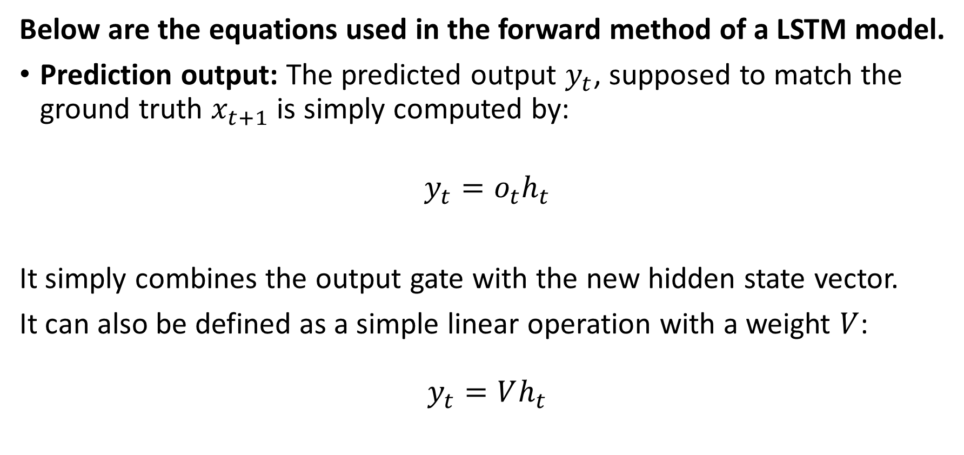
Introducing LSTM
Below are the equations used in the forward method of a LSTM model.
Prediction output: The predicted output $y_{t}$, supposed to match the ground truth $x_{t+1}$ is simply computed by:
$$y_{t}=o_{t}h_{t}$$
It simply combines the output gate with the new hidden state vector.
It can also be defined as a simple linear operation with a weight $V$:
$$y_{t}=Vh_{t}$$

Slide 26
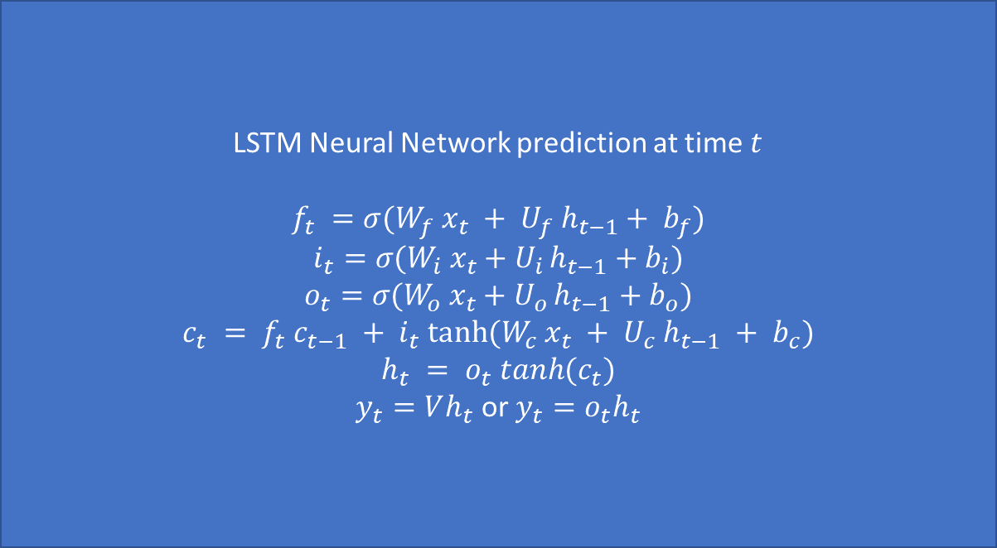
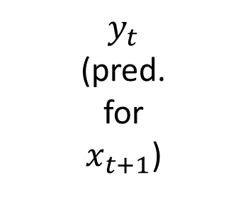



To recap, our LSTM
LSTM Neural Network prediction at time $t$
$$f_{t} =σ(W_{f} x_{t} + U_{f} h_{t−1}+ b_{f})$$
$$i_{t}​=σ​(W_{i}​{ x}_{t}​+U_{i }​h_{t−1}​+b_{i}​)$$
$$o_{t}​=σ​(W_{o}​{ x}_{t}​+U_{o }​h_{t−1}​+b_{o}​)$$
$$c_{t} = f_{t} c_{t−1} + i_{t} tanh⁡(W_{c} x_{t} + U_{c} h_{t−1} + b_{c})$$
$$h_{t} = o_{t} tanh(c_{t})$$
$y_{t}=Vh_{t}$ or $y_{t}=o_{t}h_{t}$
$$y_{t}$$
(pred. for $x_{t+1}$)
$$x_{t}$$
$$h_{t−1},c_{t−1}$$
$h_{t},c_{t}$

Slide 27
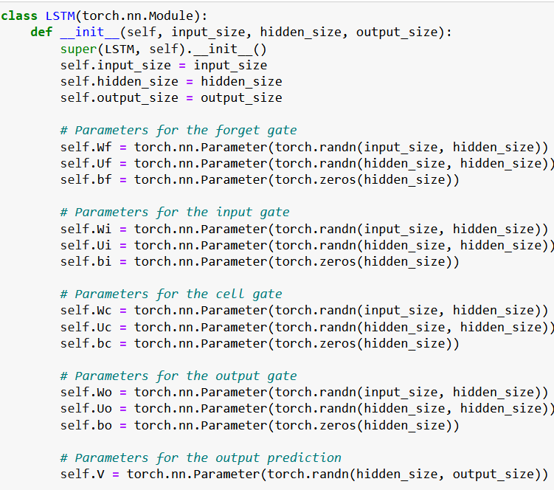
Building our own LSTM model
Let us start by defining all the weights and biases we need for each of the 6 operations we discussed.
We implement them in the init method of our class as before.
Pay attention to the sizes used for each parameter.

Slide 28
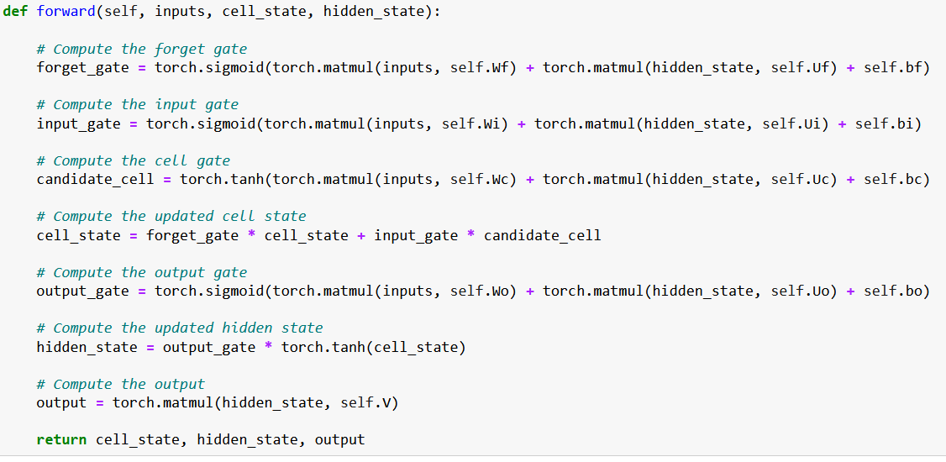
Building our own LSTM
Eventually, compute all 6 LSTM operations in the forward method.

Slide 29
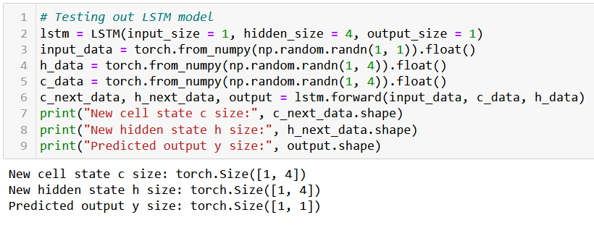
Building our own LSTM
We can then quickly check it has the expected behavior, with consistency on the sizes.

Slide 30
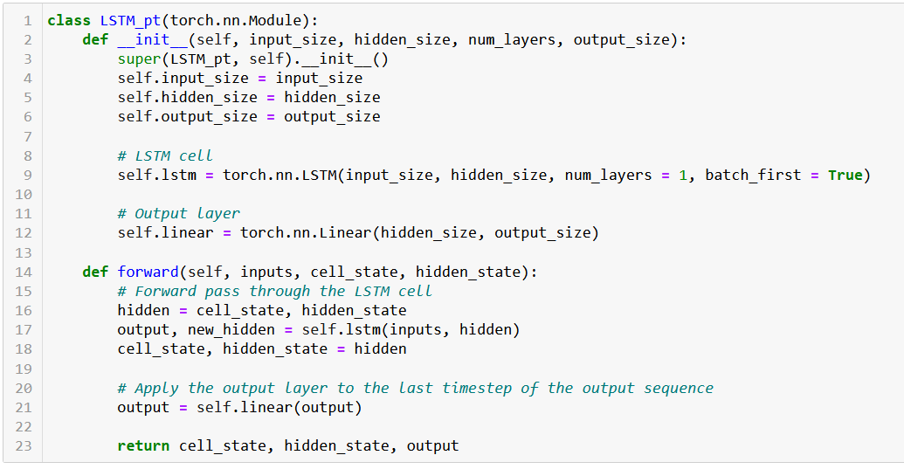
The PyTorch LSTM (equivalent to ours, but can be repeated num_layers times in a row)

Slide 31
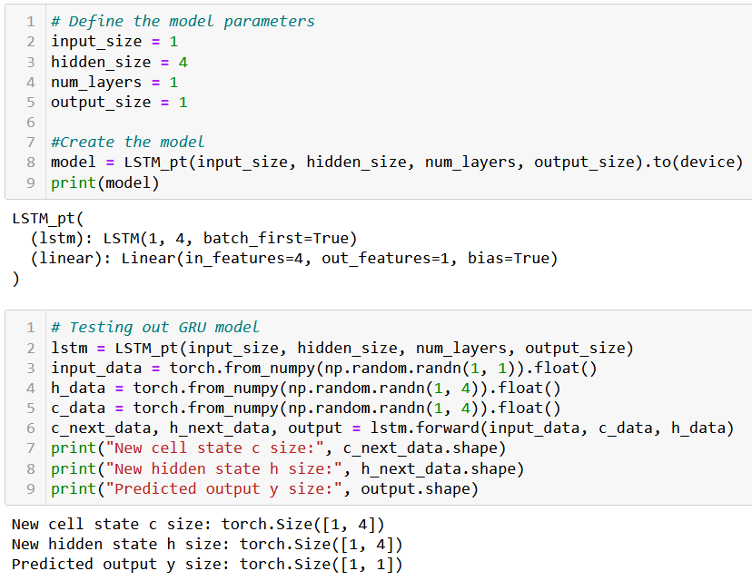
Works and ready to be trained as in NB3!

Slide 32
Introducing GRU
Definition (Gated Recurrent Units models):
Introduced in [Cho2014], Gated Recurrent Units models (or GRUs) propose to use gating mechanisms to selectively update and discard information in the hidden vector, implementing “remember” and “forget” operations of the brain.
It allows the model to selectively choose which information from the previous hidden state to retain and which to discard, in order to give more importance to recently predicted values, for instance.
In addition, this can help to maintain the gradients and avoid the vanishing gradient problem, and makes these models better suited for modeling complex time series data that exhibit long-term dependencies.

Slide 33
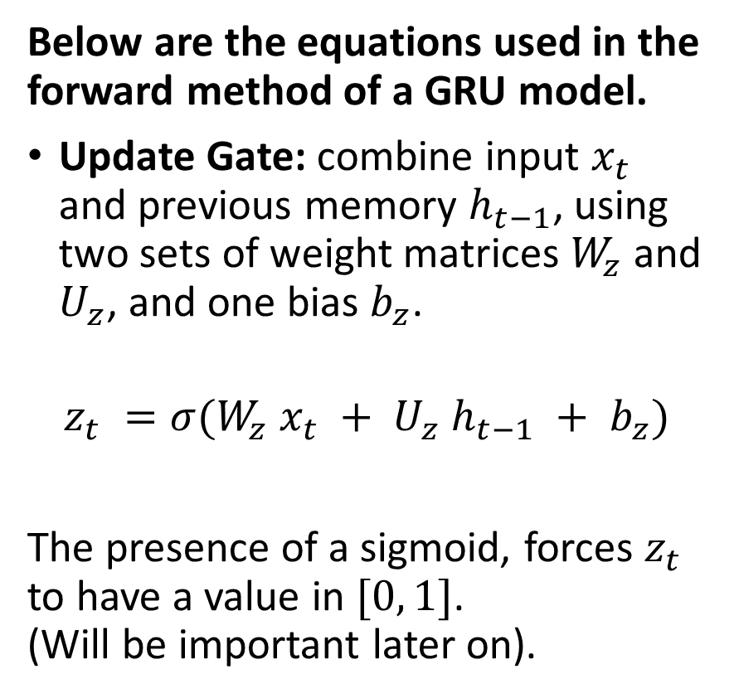
Introducing GRU
Below are the equations used in the forward method of a GRU model.
Update Gate: combine input $x_{t}$ and previous memory $h_{t−1}$, using two sets of weight matrices $W_{z}$ and $U_{z}$, and one bias $b_{z}$.
$$z_{t} =σ(W_{z} x_{t} + U_{z} h_{t−1} + b_{z})$$
The presence of a sigmoid, forces $z_{t}$ to have a value in $[0, 1]$. (Will be important later on).
The update gate will later be used by the neural network to selectively decide how much information from the previous hidden vector should be forgotten or remembered, and how much should be replaced with a newly produced memory state.
In a sense, it is similar to how the brain decide the proportion of information it should forget or replace over time.

Slide 34
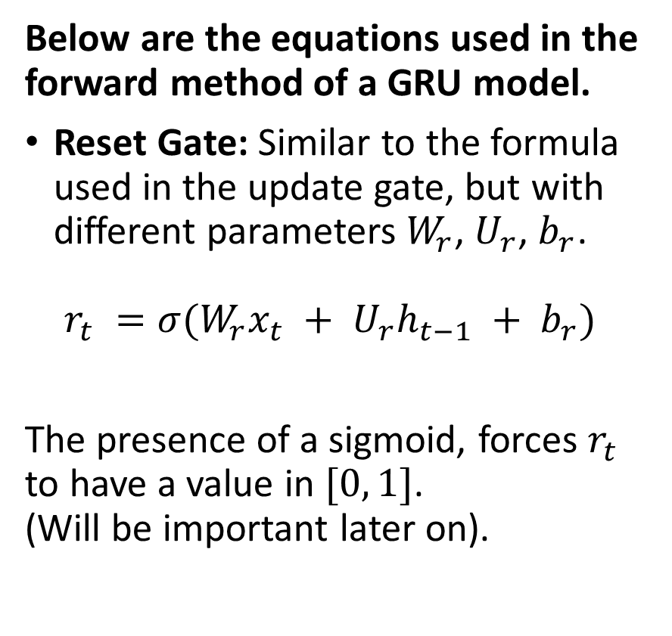
Introducing GRU
Below are the equations used in the forward method of a GRU model.
Reset Gate: Similar to the formula used in the update gate, but with different parameters $W_{r}$, $U_{r}$, $b_{r}$.
$$r_{t} =σ(W_{r}x_{t} + U_{r}h_{t−1} + b_{r})$$
The presence of a sigmoid, forces $r_{t}$ to have a value in $[0, 1]$. (Will be important later on).
The reset gate will later be used by the neural network to selectively decide how much information from the previous hidden vector should be used to compute the new memory value.
In a sense, it is similar to how the brain decide the proportion of information it should forget or remember over time.

Slide 35
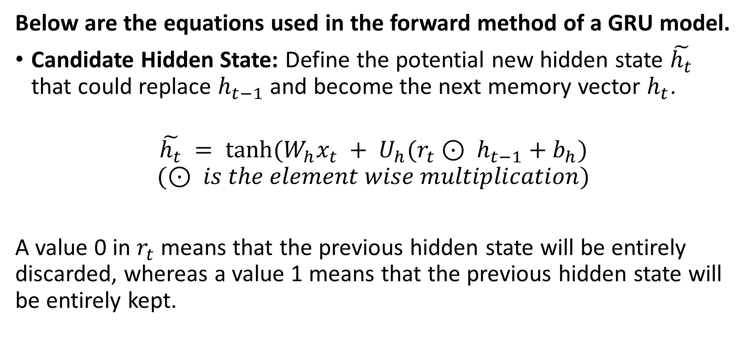
Introducing GRU
Below are the equations used in the forward method of a GRU model.
Candidate Hidden State: Define the potential new hidden state $\tilde{h_{t}}$ that could replace $h_{t−1}$ and become the next memory vector $h_{t}$.
$$\tilde{h_{t}} = tanh(W_{h}x_{t} + U_{h}(r_{t}⊙ h_{t−1}+b_{h})$$
$$(⊙ is the element wise multiplication)$$
A value 0 in $r_{t}$means that the previous hidden state will be entirely discarded, whereas a value 1 means that the previous hidden state will be entirely kept.

Slide 36
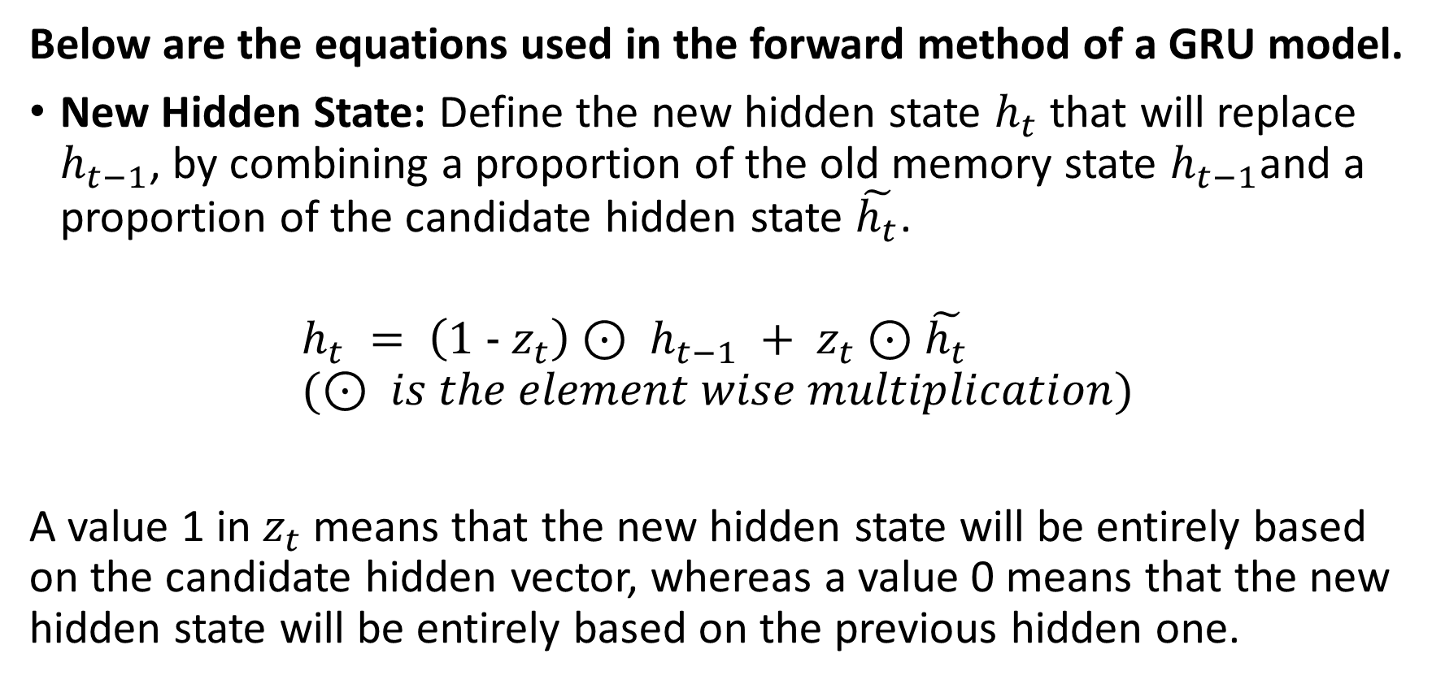
Introducing GRU
Below are the equations used in the forward method of a GRU model.
New Hidden State: Define the new hidden state $h_{t}$ that will replace $h_{t−1}$, by combining a proportion of the old memory state $h_{t−1}$and a proportion of the candidate hidden state $\tilde{h_{t}}$.
$$h_{t} = \left(1 − z_{t}\right)⊙ h_{t−1} + z_{t}⊙\tilde{h_{t}} \\ (⊙ is the element wise multiplication)$$
A value 1 in $z_{t}$means that the new hidden state will be entirely based on the candidate hidden vector, whereas a value 0 means that the new hidden state will be entirely based on the previous hidden one.

Slide 37
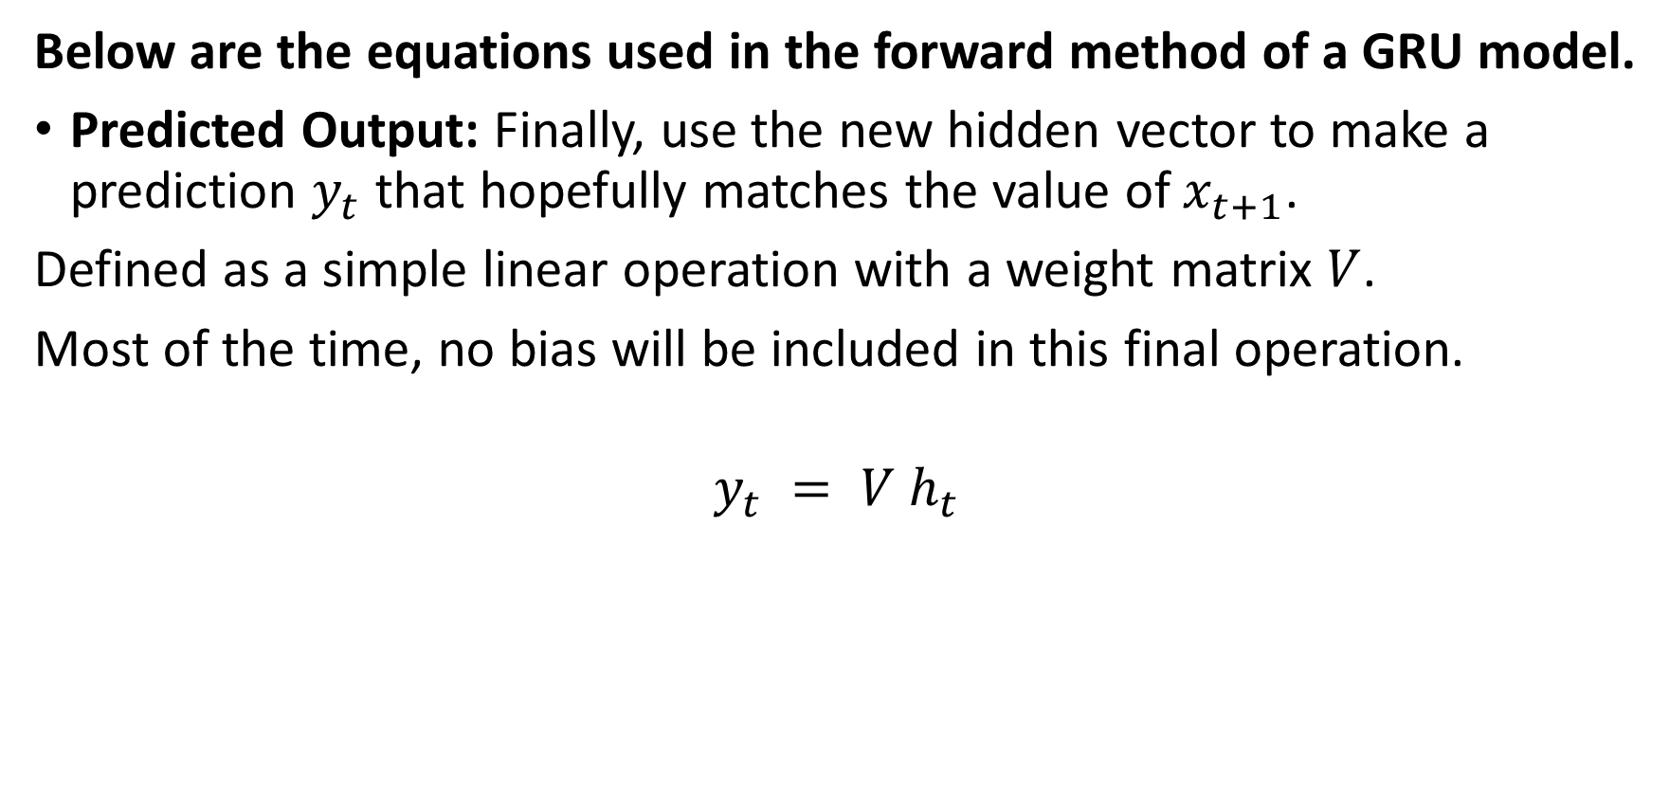
Introducing GRU
Below are the equations used in the forward method of a GRU model.
Predicted Output: Finally, use the new hidden vector to make a prediction $y_{t}$ that hopefully matches the value of $x_{t+1}$.
Defined as a simple linear operation with a weight matrix $V$.
Most of the time, no bias will be included in this final operation.
$$y_{t} = V h_{t}$$

Slide 38
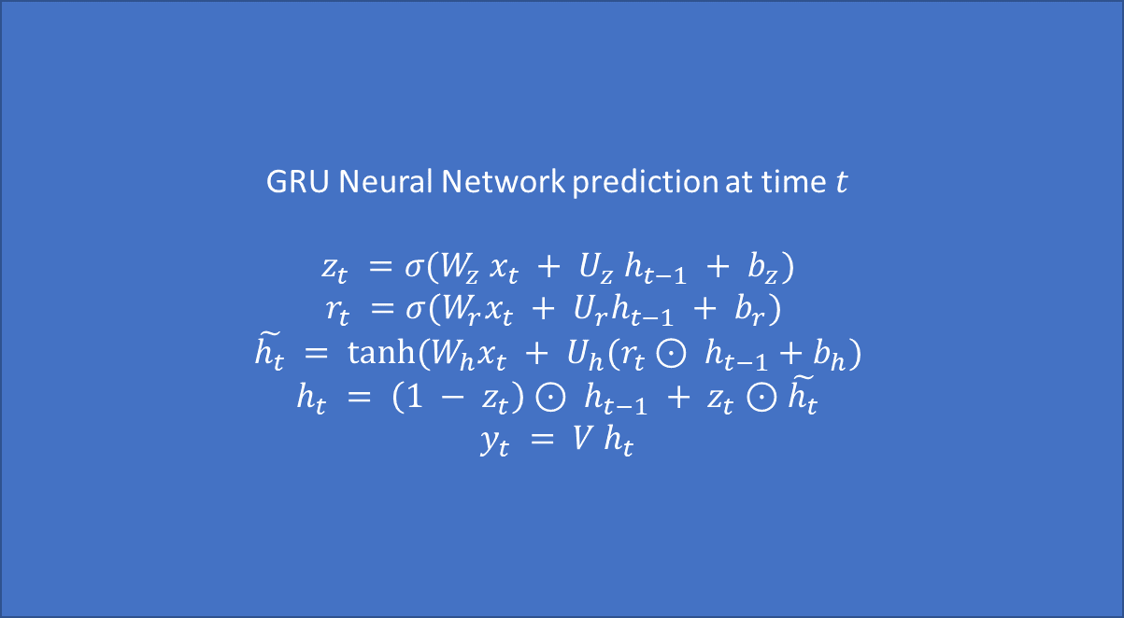


To recap, our GRU
GRU Neural Network prediction at time $t$
$$z_{t} =σ(W_{z} x_{t} + U_{z} h_{t−1} + b_{z})$$
$$r_{t} =σ(W_{r}x_{t} + U_{r}h_{t−1} + b_{r})$$
$$\tilde{h_{t}} = tanh(W_{h}x_{t} + U_{h}(r_{t}⊙ h_{t−1}+b_{h})$$
$$h_{t} = \left(1 − z_{t}\right)⊙ h_{t−1} + z_{t}⊙\tilde{h_{t}}$$
$$y_{t} = V h_{t}$$
$$y_{t}$$
(pred. for $x_{t+1}$)
$$x_{t}$$
$$h_{t−1}$$
$$h_{t}$$

Slide 39
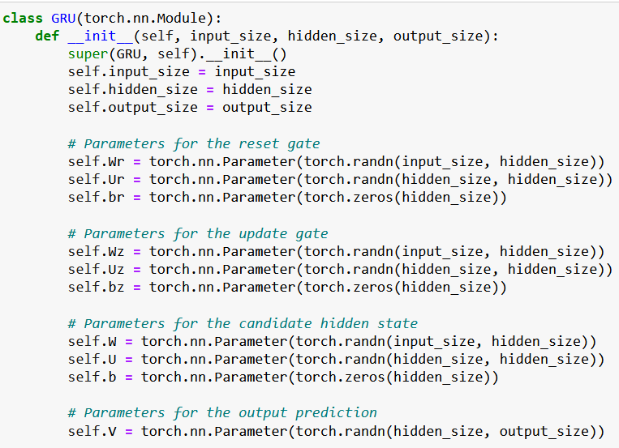
Building our own GRU
Let us start by defining all the weights and biases we need for each of the 5 operations we discussed.
We implement them in the init method of our class as before.
Pay attention to the sizes used for each parameter.

Slide 40
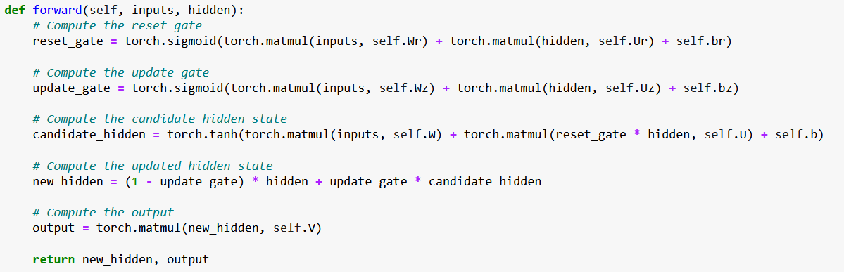
Building our own GRU
Eventually, compute all 5 GRU operations in the forward method.

Slide 41
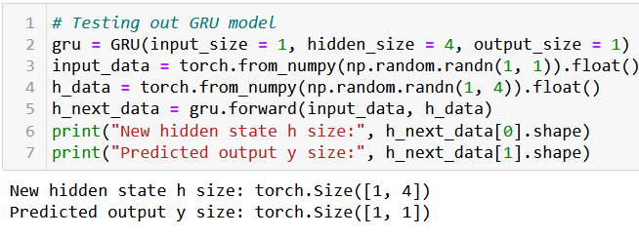
Building our own GRU
We can then quickly check it has the expected behavior, with consistency on the sizes.

Slide 42
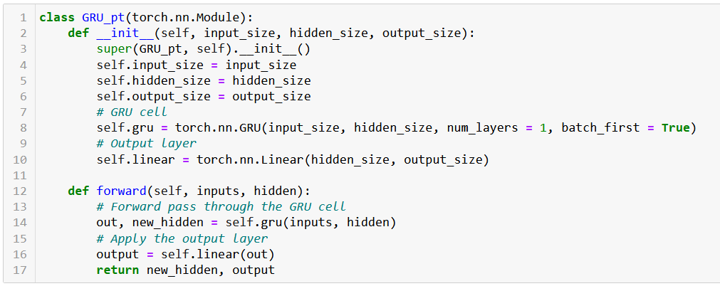
The PyTorch GRU (equivalent to ours, but can be repeated num_layers times in a row)

Slide 43
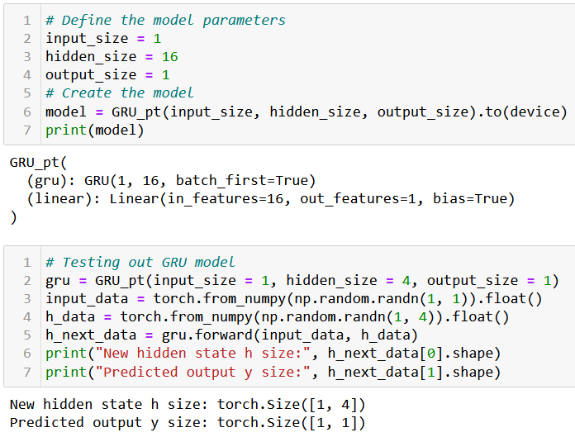
Works and ready to be trained as in NB3!

Slide 44
LSTMs vs. GRUs
Both LSTM and GRU networks are effective at capturing long-term dependencies in time series data.
There are however some benefits to using LSTMs over GRUs:
LSTMs are designed to maintain and propagate information over longer time lags than GRUs. This makes them better suited for tasks that require the network to retain information for longer periods of time, such as language modelling or speech recognition.
LSTMs have more parameters than GRUs, which can make them more expressive and better able to model complex nonlinear functions. This can be beneficial in tasks that require a high level of accuracy, such as image or speech recognition.
LSTMs can handle input sequences of variable lengths more effectively than GRUs, as they have an explicit memory cell that can store information over multiple timesteps. This can be useful in applications where the length of the input sequence may vary, such as natural language processing.

Slide 45
LSTMs vs. GRUs
Of course, there are also some benefits to using GRUs over LSTMs:
GRUs have fewer parameters than LSTMs, which can make them faster to train and less prone to overfitting.
GRUs have a simpler structure than LSTMs, which can make them easier to implement and understand.
GRUs can be more effective than LSTMs in handling sequences that have a lot of noise or missing data, as they are better able to adapt to changes in the input.
GRUs can be more computationally efficient than LSTMs, as they have fewer computations per time step.
GRUs are better suited for tasks that require the network to prioritize recently observed information over older information. This is because GRUs have a gating mechanism that is designed to selectively update and discard information in the hidden state, which makes them better able to model short-term dependencies.

Slide 46
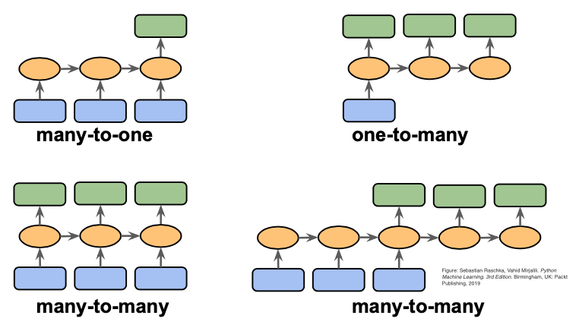
A quick word on one/many-to-one/many models

Slide 47
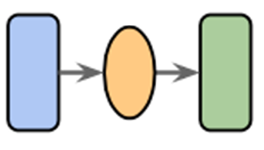
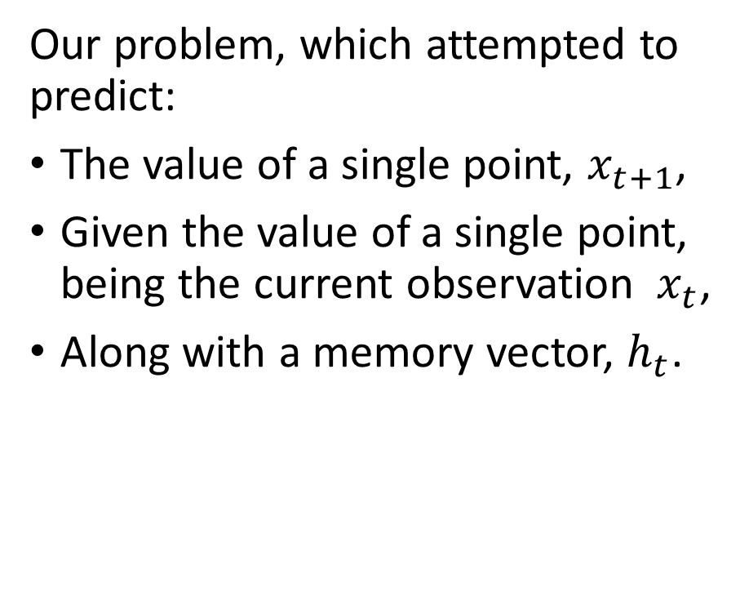
One-to-one models
Definition (one-to-one models):
A one-to-one model is a machine learning model that:
Takes a single input,
And, optionally, a memory vector,
And attempts to produce a single output.
This can be seen as the simplest type of machine learning problem.
Our problem, which attempted to predict:
The value of a single point, $x_{t+1}$,
Given the value of a single point, being the current observation $x_{t}$,
Along with a memory vector, $h_{t}$.

Slide 48
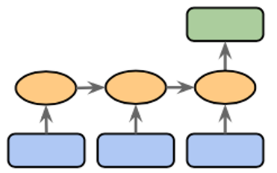
Many-to-one models
Definition (many-to-one models):
A many-to-one model is a machine learning model that:
Takes many inputs,
And, optionally, a memory vector,
And attempts to produce a single output.
This is another common type of ML problem we have seen so far.

Slide 49
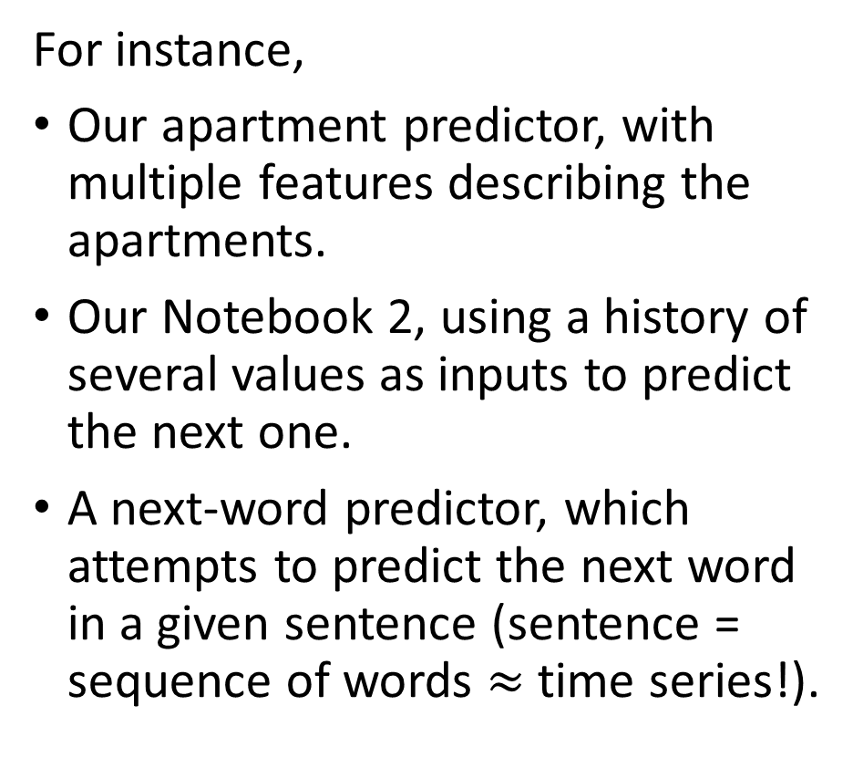
Many-to-one models
Definition (many-to-one models):
A many-to-one model is a machine learning model that:
Takes many inputs,
And, optionally, a memory vector,
And attempts to produce a single output.
This is another common type of ML problem we have seen so far.
For instance,
Our apartment predictor, with multiple features describing the apartments.
Our Notebook 2, using a history of several values as inputs to predict the next one.
A next-word predictor, which attempts to predict the next word in a given sentence (sentence = sequence of words $≈$ time series!).

Slide 50
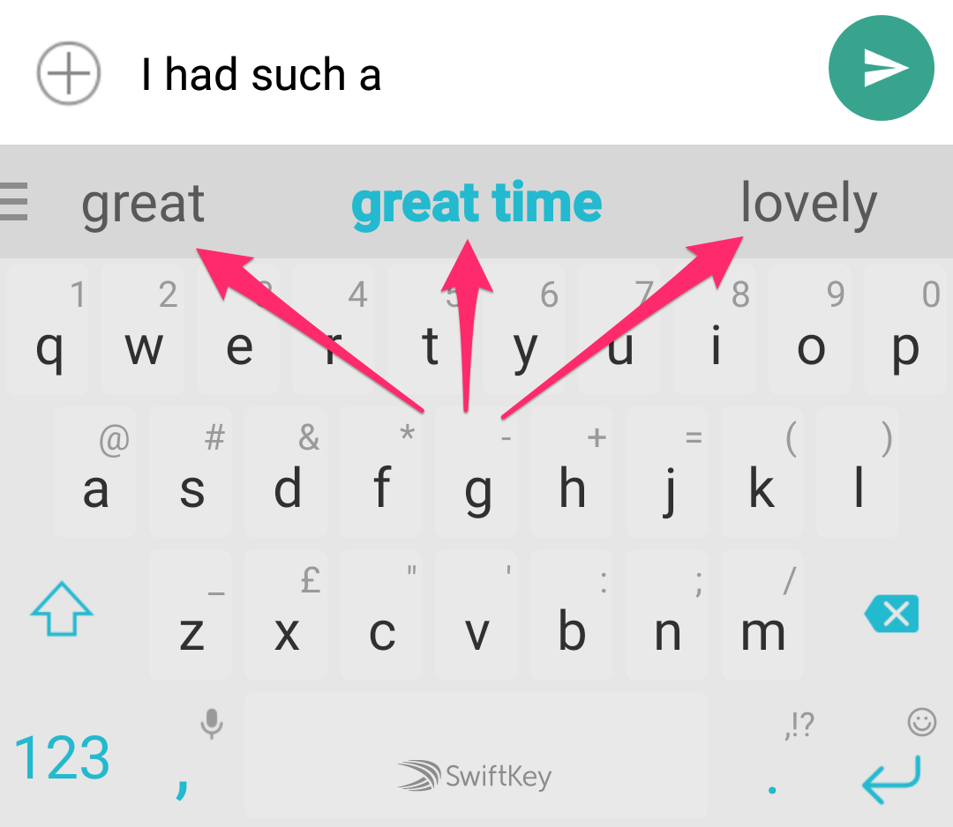

Many-to-one models
Definition (many-to-one models):
A many-to-one model is a machine learning model that:
Takes many inputs,
And, optionally, a memory vector,
And attempts to produce a single output.
This is another common type of ML problem we have seen so far.
For instance,
Our apartment predictor, with multiple features describing the apartments.
Our Notebook 2, using a history of several values as inputs to predict the next one.
A next-word predictor, which attempts to predict the next word in a given sentence (sentence = sequence of words $≈$ time series!).

Slide 51
Many-to-one models
Definition (many-to-one models):
A many-to-one model is a machine learning model that:
Takes many inputs,
And, optionally, a memory vector,
And attempts to produce a single output.
This is another common type of ML problem we have seen so far.
It would be possible to use a RNN of some sort for these problems, and only keep the final output (discarding all other calculated in the process), to compute a loss function of some sort.

Slide 52

One-to-many models
Definition (one-to-many models):
A one-to-many model is…
You get what it means now.
To be honest, very few problems fall in the category of one-to-many, because most of the time we prefer to have a higher dimensionality on inputs than outputs…

Slide 53

Many-to-many models
Definition (many-to-many models):
A many-to-many model is a machine learning model that:
Takes many inputs,
And, optionally, a memory vector,
And attempts to produce many outputs.
This is also a very common type of ML problems, which we will investigate more on the coming weeks.

Slide 54
Many-to-many models
Definition (many-to-many models):
A many-to-many model or model is a machine learning model that:
Takes many inputs,
And, optionally, a memory vector,
And attempts to produce many outputs.
We will investigate more of these in the coming weeks.
For instance,
A predictor giving the price to buy and rent for a given apartment and its many features.
A stock market predictor that takes several points as inputs (history) and attempts to predict the next few values of the stock prices instead of one.
A translation model that translates text from English to French.

Slide 55

Many-to-many models
Definition (many-to-many models):
A many-to-many model or model is a machine learning model that:
Takes many inputs,
And, optionally, a memory vector,
And attempts to produce many outputs.
We will investigate more of these in the coming weeks.
For instance,
A predictor giving the price to buy and rent for a given apartment and its many features.
A stock market predictor that takes several points as inputs (history) and attempts to predict the next few values of the stock prices instead of one.
A translation model that translates text from English to French.

Slide 56
Many-to-many models
→ But then, what is the difference between these two diagrams?

Slide 57
Seq2Seq models
Definition (Seq2Seq models):
A Sequence-to-Sequence (Seq2Seq) model is a special type of many-to-many model, where the inputs and outputs being produced are sequences.
The apartment predictor with multiple outputs/inputs is not Seq2Seq!
But the other two are:
A stock market predictor that takes several points as inputs (history) and attempts to predict the next few values of the stock prices instead of one.
A translation model that translates text from English to French.

Slide 58
Encoder and Decoder models
Definition (encoder and decoder models):
In general, the first part of the model will focus on analysing the input, eventually producing a single memory vector output. This is called an encoder.
Can be done with a RNN of some sort, where the final memory state consists of the encoding vector.
E.g. read an English sentence, progressively encoding each word, and eventually the entire sentence meaning in a single encoding vector.

Slide 59
Encoder and Decoder models
Definition (encoder and decoder models):
In general, the second part of the model will focus on analysing the produced encoding vector, and producing a sequence of some sort as output. This is called an decoder.
Can be done with the same (or another) RNN of some sort, where the first memory state consists of the encoding vector.
E.g. read an encoding vector describing an English sentence and produce an output sequence being the French translation.

Slide 60
Encoder and Decoder models
The encoder model can be seen as a many-to-one model of some sort, receiving a sequence as input and producing a single vector of interest as output.
The decoder model would be a many-to-one model of some sort, receiving this single encoding vector as input and producing a sequence as output.

Slide 61
Encoder + Decoder = Seq2Seq?
Eventually both the encoder and the decoder models will assemble into a Seq2Seq model.

Slide 62

A quick word on autoregressive RNNs
Our previous RNN models looked like this: start with an empty memory vector $h_{0}$, predict $y_{t}$ and update memory vector $h_{t}$using a new observation $x_{t}$ as input on each time step.

Slide 63

A quick word on autoregressive RNNs
Important: our RNNs models would not be using our prediction $y_{t}$ as the new observation for the next step $x_{t+1}$!

Slide 64

A quick word on autoregressive RNNs
But what if we did?
$$Use y_{1}$$
$$as x_{2}?$$

Slide 65


A quick word on autoregressive RNNs
Definition (autoregressive RNNs):
An autoregressive RNN, is a special type of RNN, which reuses the previous predictions in place of the next observation to make the next prediction. Basically connecting $y_{t}$ and $x_{t+1}$.
This is usually harder to train, as you would only use the “real” observed value $x$ at $t=1$. After that use your own predictions $y_{t}$ in place of $x_{t+1}$!
Bonjour Mon Cher Ami

Slide 66
A quick word on autoregressive RNNs
Typically, we love to use these models in Natural Language Processing, for instance when it comes to generating output sequences.
E.g. generate an English sentence for a given encoding vector describing the meaning of a French sentence.
Bonjour Mon Cher Ami

Slide 67
A quick word on autoregressive RNNs
Encoder reads the French sentence and produces an encoding vector Se as the final memory vector.
Bonjour Mon Cher Ami

Slide 68

A quick word on autoregressive RNNs
Decoder part receives this encoding vector as the initial memory vector value $h_{0}$ and the first value $x_{1}$ is $<s>$, a special character indicating the beginning of a sequence.
The first word “hello” is produced as $y_{1}$ and reused as $x_{2}$, to produce the next word “my”.
Until eventually, another special token $</s>$is produced, indicating the end of the sentence.
Bonjour Mon Cher Ami

Slide 69
A quick word on autoregressive RNNs
Typically, ChatGPT is a Seq2Seq model using autoregressive RNNs!
Takes a sequence of words as input,
And reconstructs answer, a sentence, one word at a time!

Slide 70
A quick word on autoregressive RNNs
Typically, ChatGPT is a Seq2Seq model using autoregressive RNNs!
Takes a sequence of words as input,
And reconstructs answer, a sentence, one word at a time!
We will learn more about these during Week 8!
(And during the NLP specialty course on Term 8!)

Slide 71
Conclusion (Week 6)
Time series datasets
Deep learning models with history
History length tradeoffs
Implementing memory in Deep Learning models
Our first vanilla Recurrent Neural Network with memory
The vanishing gradient problem in RNNs
The LSTM model
The GRU model
One/Many-to-one/many models
Seq2Seq models
Encoder and Decoder architectures
Autoregressive RNNs
(More on these during W8!)

Slide 72
Learn more about these topics
Out of class, supporting papers, for those of you who are curious.
[Hochreiter1997] S. Hochreiter and J. Schmidhuber “Long short-term memory”, 1997.
[Gers2013] F. A. Gers, J. Schmidhuber, F. Cummin, “Learning to forget: Continual prediction with LSTM”, 2013.
[Cho2014] K. Cho, B. van Merrienboer, C. Gulcehre, D. Bahdanau, F. Bougares, H. Schwenk, and Y. Bengio, “Learning Phrase Representations using RNN Encoder-Decoder for Statistical Machine Translation”, 2014.

Slide 73
Learn more about these topics
Tracking important names (Track their works and follow them on Scholar, Twitter, or whatever works for you!)
Kyunghyun Cho: Professor at New York University. https://scholar.google.co.uk/citations?user=0RAmmIAAAAAJ&hl=en https://kyunghyuncho.me/
Dzmitry Bahdanau: Research Scientist at Element AI and Adjunct Professor at McGill University. https://scholar.google.de/citations?user=Nq0dVMcAAAAJ&hl=en https://rizar.github.io/

Slide 74
Learn more about these topics
Tracking important names (Track their works and follow them on Scholar, Twitter, or whatever works for you!)
Jürgen Schmidhuber: Professor at the University of Lugano in Switzerland. https://scholar.google.com/citations?user=gLnCTgIAAAAJ&hl=fr https://people.idsia.ch/~juergen/
Sepp Hochreiter: Professor at the Johannes Kepler University of Linz in Austria. https://scholar.google.at/citations?user=tvUH3WMAAAAJ&hl=en https://www.iarai.ac.at/people/sepphochreiter/

Slide 75
Learn more about these topics
Some extra (easy) reading and videos for those of you who are curious.
[LesleyEdu] “How Memories Are Made: Stages of Memory Formation”, explains in simple terms how the human brain processes information and generates memory. https://lesley.edu/article/stages-of-memory
[Medium] “GPT-3, RNNs and All That: A Deep Dive into Language Modelling”, explains how Large Language Models (such as ChatGPT) work using autoregressive RNNs. Note: the transformer part will be covered on Week 8! https://towardsdatascience.com/gpt-3-rnns-and-all-that-deep-dive-into-language-modelling-7f67658ba0d5

